Slide 1


GPU Programming (in CUDA)
Spring 2019
Julian Gutierrez
Session 5

Slide 2
Outline
Lab 2
CUDA Memory Model
Overview and Concepts
Global Memory
Registers
Local Memory
Shared Memory
Caches
Constant Memory and Texture Memory
Synchronization

Slide 3
Lab 2
Any questions regarding the lab?
Please note: I will provide a prewritten code for all of the labs. Before modifying it, go over it and understand what it does.

Slide 4
CUDA Memory Model

Slide 5
CUDA Memory Model
Why do we need to understand the memory model?
Memory accesses will affect performance drastically
Memory patterns allow you to control these effects
Maximize resource usage by taking care of the LD/ST units
To do this, we use data locality

Slide 6
CUDA Memory Model
Generally, applications don’t have random accesses
Random accesses are very hard to improve
Having locality in our data helps improve the performance
There are two types of data locality that memory architectures make use of
Temporal locality
Useful data tends to continue being useful
Spatial locality
Useful data tends to be followed by more useful data
Notes:
Explain how a cache works. Uses these two to keep program execution running.
Caches are a memory that is really close to the processor (fast, but small because its expensive).
They use temporal locality because stuff that the processor needs, it keeps it there because theres a high probability it will request it again
They use spatial locality because when a processor requests data, it brings that data and more (a block) because theres a possibility it will use that data too.

Slide 7
CUDA Memory Model
Example
CPU Caches
They bring more than just the address being requested (block of memory)
They remove the least recently used block from the cache when a new block comes in (eviction)
GPUs exploit locality at different levels of the memory model
Notes:
Explain how a cache works. Uses these two to keep program execution running.
Caches are a memory that is really close to the processor (fast, but small because its expensive).
They use temporal locality because stuff that the processor needs, it keeps it there because theres a high probability it will request it again
They use spatial locality because when a processor requests data, it brings that data and more (a block) because theres a possibility it will use that data too.

Slide 8
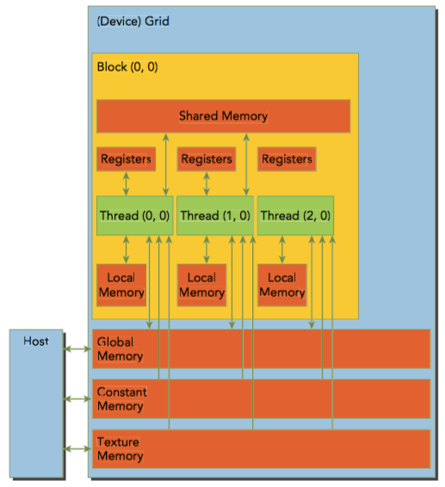
CUDA Memory Model
Memories available on the GPU
Registers
Shared Memory
Local Memory
Constant Memory
Texture Memory
Global Memory

Slide 9
CUDA Memory Model
Global Memory
Resides in device memory
Global scope: device level
Largest memory on the GPU
Highest latency (~100s of cycles)
If it’s so slow, how can we use it efficiently?

Slide 10
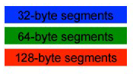

CUDA Memory Model
Global Memory
Accesses are organized by half warps (16 threads)
Accesses are done in 32, 64 and 128 byte segments
Consecutive addresses are read quickly
Certain non-sequential access patterns to global memory degrade performance
Allocations are aligned to multiples of 256 bytes (or more) for performance purposes
Accesses can be done in as little as one transactions for all the half warp, under certain conditions

Slide 11
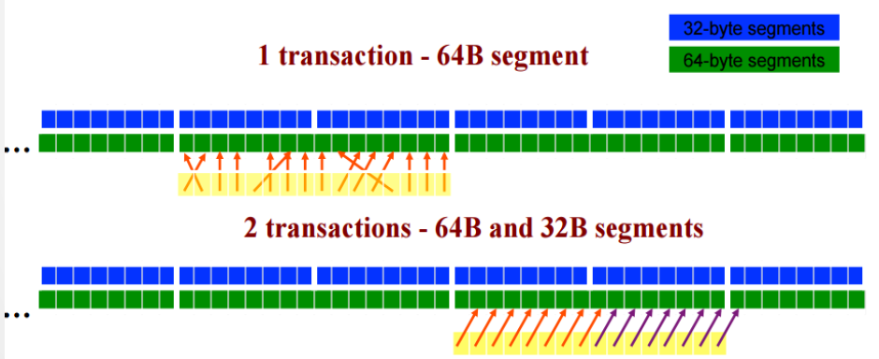
CUDA Memory Model
Global Memory
This concept is called Memory Coalescing
Find the segment containing the address request of the lowest numbered active thread
Find all other active threads requesting in same segment
Reduce transaction size (if possible)
Mark the service threads as inactive
Repeat until all threads in ½ warp
are complete

Slide 12
CUDA Memory Model
Example: 2D data
All warps in a block access consecutive elements within a row as they step through neighboring columns.
Accesses by threads in a block along a column don’t coalesce.

Slide 13
CUDA Memory Model
In Summary
GM has very high latency (~100 cycles per read)
Resides in the RAM memory of the GPU
We want half a warp to access addresses that fall into same 32, 64 or 128 byte blocks to coalesce the reads (convert multiple memory requests into a single one)
Basically… We want very predictable and ordered accesses in memory. We will discuss this further in the hands-on lab.

Slide 14
CUDA Memory Model
Registers
The fastest memory
Variables are automatically assigned to registers
Some arrays might be declare as registers if the size is determined at compilation time and are fairly small

Slide 15

CUDA Memory Model
Registers
The fastest memory
Variables are automatically assigned to registers
Some arrays might be declare as registers if the size is determined at compilation time and are fairly small
__global__ void matrixMulKernel( float *devA, float *devB, float *devC, int row, int col, int k){
int txID = blockIdx.x * blockDim.x + threadIdx.x;
int tyID = blockIdx.y * blockDim.y + threadIdx.y;
if ((txID < col) && (tyID < row))
{
float Pvalue = 0;
for(int w=0; w<k; w++)
{
Pvalue += devA[tyID*k+w] * devB[w*k+txID];
}
devC[tyID*k+txID] = Pvalue;
}
}
Registers

Slide 16
CUDA Memory Model
Registers
Remember: Register File size is 64 K entries
Registers are private for each thread.
Kepler supports a maximum of 255 registers per thread.
Example:
nvcc -Xptxas -v,-abi=no matrixMul.cu -o matrixMul
ptxas warning : 'option -abi=no' might get deprecated in future
ptxas info : 0 bytes gmem
ptxas info : Compiling entry function '_Z15matrixMulKernelPfS_S_iii' for 'sm_20'
ptxas info : Used 14 registers, 68 bytes cmem[0]
Note: Parallel Thread Execution (PTX) is a pseudo-assembly language used in Nvidia's CUDA programming environment

Slide 17
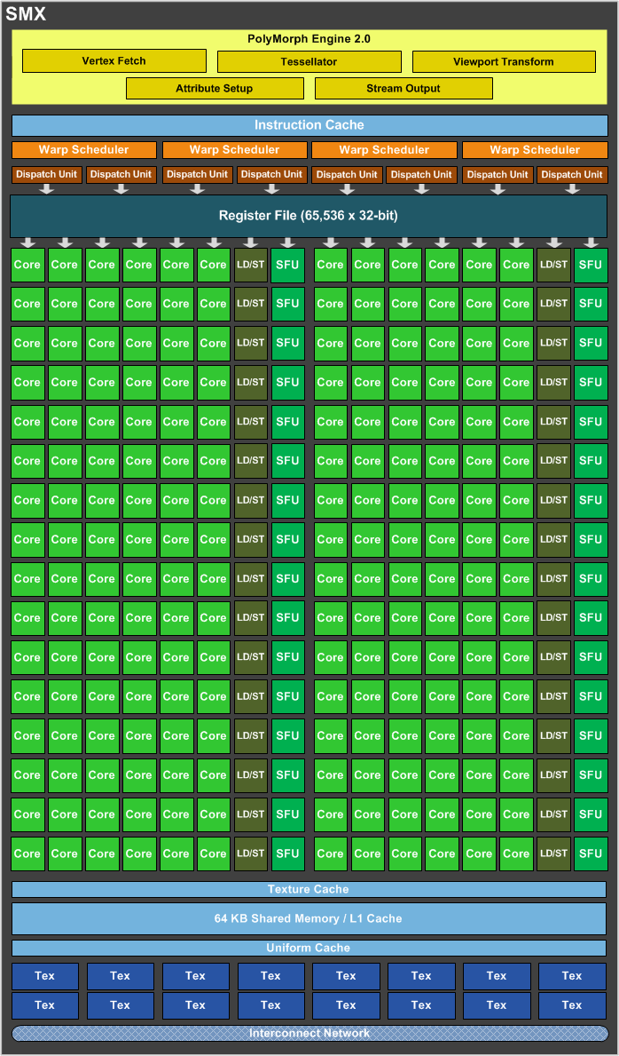
CUDA Memory Model
Registers
What happens if we exceed register hardware limit?
Spills!
It will significantly impact performance.
It will spill to local memory.
Where is Local Memory?
In DEVICE MEMORY!

Slide 18
CUDA Memory Model
Local Memory
Variables that cannot fit on the registers space go to Local Memory
Local array that indexes cannot be defined in compilation time
Large local array that consumes too much register space
Any variable that doesn’t fit in the register limit
Remember, Local memory is actually stored in DEVICE MEMORY!
The reads to Local Memory are as slow as Global Memory… kind of…
In the Kepler Architecture, LM reads are cached in L1 cache, GM reads aren’t (by default)

Slide 19
CUDA Memory Model
Shared Memory
It is on-chip, therefore:
It has a much higher bandwidth
Lower latency
Much smaller size
It works at a block-level granularity
Threads in a block can access the same shared memory space
When a block is done, its shared memory will be released
Use __syncthreads() to synchronize threads in the block to avoid hazards or race conditions

Slide 20
CUDA Memory Model
Shared Memory
It can be declared in the kernel (statically) or in the kernel call (dynamically).
Use attribute: __shared__
__global__ void staticReverse(int *d, int n) {
__shared__ int s[64];
int t = threadIdx.x;
int tr = n-t-1;
s[t] = d[t];
__syncthreads();
d[t] = s[tr];
}
__global__ void dynamicReverse(int *d, int n) {
extern __shared__ int s[];
int t = threadIdx.x;
int tr = n-t-1;
s[t] = d[t];
__syncthreads();
d[t] = s[tr];
}

Slide 21
CUDA Memory Model
Shared Memory
It can be declared in the kernel (statically) or in the kernel call (dynamically).
Use attribute: __shared__
…
// run version with static shared memory
cudaMemcpy(d_d, a, n*sizeof(int), cudaMemcpyHostToDevice);
staticReverse<<<1,n>>>(d_d, n);
cudaMemcpy(d, d_d, n*sizeof(int), cudaMemcpyDeviceToHost);
for (int i = 0; i < n; i++) if (d[i] != r[i])
printf("Error: d[%d]!=r[%d] (%d, %d)n", i, i, d[i], r[i]);
// run dynamic shared memory version
cudaMemcpy(d_d, a, n*sizeof(int), cudaMemcpyHostToDevice);
dynamicReverse<<<1,n,n*sizeof(int)>>>(d_d, n);
cudaMemcpy(d, d_d, n * sizeof(int), cudaMemcpyDeviceToHost);
for (int i = 0; i < n; i++) if (d[i] != r[i])
printf("Error: d[%d]!=r[%d] (%d, %d)n", i, i, d[i], r[i]);
..
What if you need multiple dynamically sized arrays in a single kernel?
You must declare a single extern unsized array as before, and use pointers into it to divide it into multiple arrays
Basically, don’t do it...
Just don’t…

Slide 22
CUDA Memory Model
Shared Memory
Another positive feature is that it is programmable on Kepler Architecture.
You can assign the amount of memory you need.
Shared memory and the L1 cache use the same physical space of 64K on-chip memory
cudaDeviceSetCacheConfig(cudaFuncCachePreferL1);
Options are:
cudaFuncCachePreferL1
cudaFuncCachePreferShared
cudaFuncCachePreferEqual

Slide 23
CUDA Memory Model
Shared Memory
This is usually the best way to optimize your algorithms memory behavior if there are multiple accesses to those memory addresses.
Example:
__global__ void compute_it(float *data) {
int tid = threadIdx.x;
__shared__ float myblock[1024];
float tmp;
// load the thread's data element into shared memory
myblock[tid] = data[tid];
// ensure that all threads have loaded their values into
// shared memory; otherwise, one thread might be computing
// on uninitialized data.
__syncthreads();
// compute the average of this thread's left and right neighbors
tmp = (myblock[tid>0?tid-1:1023] + myblock[tid<1023?tid+1:0]) * 0.5f);
// square the previousr result and add my value, squared
myblock[tid] = tmp*tmp + myblock[tid]*myblock[tid];
// write the result back to global memory
data[tid] = myblock[tid];
}

Slide 24
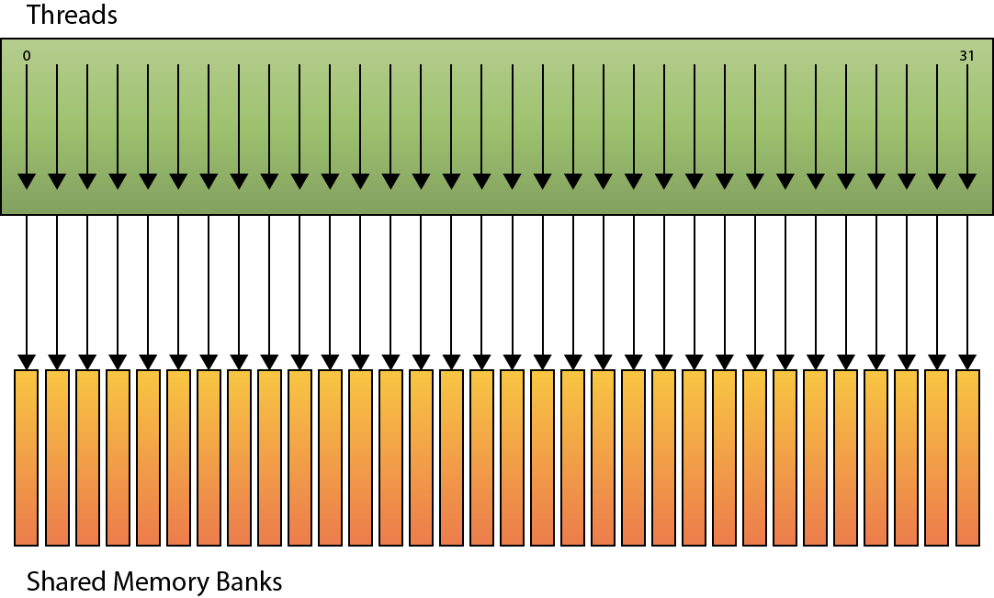
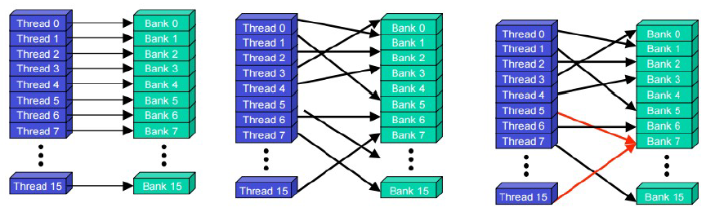
CUDA Memory Model
Shared Memory
So, why is Shared Memory so fast?
Shared memory is divided into banks.

Slide 25
CUDA Memory Model
Shared Memory
Successive 32 bit words are assigned to successive banks
For devices of compute capability 2.x or higher (fermi)
Number of banks = 32
Bandwidth is 32 bits per bank per 2 clock cycles
Shared memory requests for a warp are not split
Increased susceptibility to conflicts
But no conflicts if access to bytes in same 32 bit word

Slide 26
CUDA Memory Model
Shared Memory
Access to shared memory is fast unless:
2 or more threads in a warp access the same bank: we have a conflict
If two or more addresses of a memory request are in the same bank, the accesses are serialized (Bank conflicts exist only within a warp)
Exception: if all access the same address: broadcast

Slide 27
CUDA Memory Model
Shared Memory
R
R
R
R
R
R
R
R
R
R
R
R
R
R
R
R
R
R
R
R
R
R
R
R
R
R
R
R
R
R
R
R

Slide 28
CUDA Memory Model
Shared Memory
R
R
R
R
R
R
R
R
R
R
R
R
R
R
R
R
R
R
R
R
R
R
R
R
R
R
R
R
R
R
R
R

Slide 29
CUDA Memory Model
Shared Memory
R
R
R
R
R
R
R
R
R
R
R
R
R
R
R
R
R
R
R
R
R
R
R
R
R
R
R
R
R
R
R
R

Slide 30
CUDA Memory Model
Shared Memory
R
R
R
R
R
R
R
R
R
R
R
R
R
R
R
R
R
R
R
R
R
R
R
R
R
R
R
R
R
R
R
R

Slide 31
CUDA Memory Model
In summary
Very Fast (2 cycles per read)
Divided into banks (32)
We don’t want to access the same bank with threads in the same warp (bank conflicts, serialize the reads) unless they all access the same 32 bit address (we can broadcast the value to all the threads)
Very useful if addresses are requested multiple times from global memory (reduce the reads from global memory).
Requires extra manual work, and synchronization between threads in a block

Slide 32
CUDA Memory Model
Caches
Non-programmable memory
Four types of caches:
L1 cache
L2 cache
Read-only constant memory
Read-only texture memory

Slide 33
CUDA Memory Model
Caches
One L1 per-SM
One L2 for all SMs
L1 and L2 store data for local and global memory (that includes register spills)
GPUs like Kepler can configure that reads are cached in L1 and L2, or just L2 (default)
Memory store operations cannot be cached

Slide 34
CUDA Memory Model
Constant Memory
Read-only and resides on device memory
It has its own separate cache
It has to be declared on a global scope outside of the kernel
Limited resource: 64K for all compute capabilities
Use attribute: __constant__

Slide 35
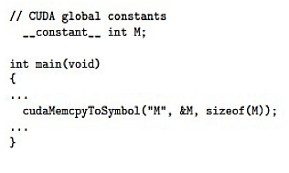
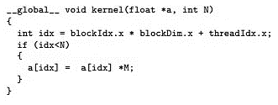
CUDA Memory Model
Constant Memory
Host has to initialize it:
It performs better when all threads in a warp access the same memory address
DON’T USE IT if all threads in a warp access different memory addresses and is only accessed once
The variables in constant memory don’t have to be declared in the kernel invocation
cudaError_t cudaMemcpyToSymbol(const void* symbol, const void* src, size_t count);

Slide 36
CUDA Memory Model
Constant Memory
Declaring memory as constant constrains the usage to read-only
Reading from constant memory can conserve memory bandwidth when compared to reading the same data from global memory.
There are 2 reasons why reading from 64 KB constant memory saves bandwidth:
A single read from constant memory can be broadcasted to other threads, effectively saving up to 15 reads.
Constant memory is cached, so consecutive read of the same address will not incur any additional memory traffic.

Slide 37
CUDA Memory Model
Constant Memory
There can be a downgrade of the performance when using constant memory
The half-warp broadcast feature can degrade the performance when all 16 threads read different addresses
If all 16 threads in a half-warp need different data from constant memory, the 16 different reads get serialized

Slide 38
CUDA Memory Model
Texture Memory
It resides in device memory as well
It is cached in a per-SM fashion
It belongs to the scope of global memory but it is accessed through a dedicated read-only cache
Recommended for use when data has 2D (3D) spatial locality (i.e. imaging)

Slide 39
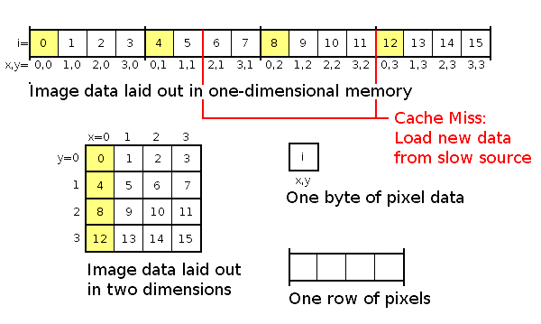
CUDA Memory Model
Texture Memory
Example of how 2D spatial locality could work

Slide 40
CUDA Memory Model
Texture Memory
Example of how 2D spatial locality could work (Z-ORDER)
Regular Memory Addresses
Reordered Memory Addresses

Slide 41
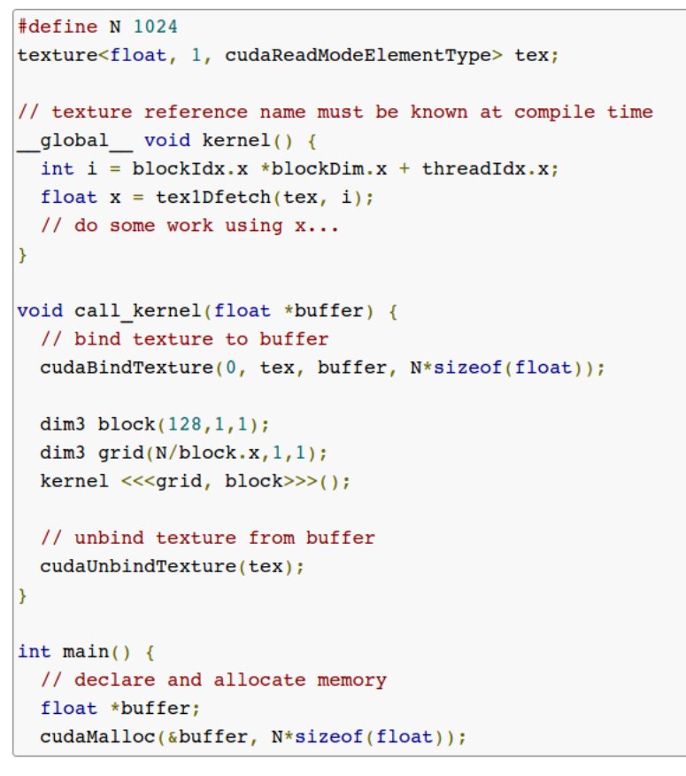
CUDA Memory Model
Texture Memory
The easiest way to use texture memory, is by reference.

Slide 42
CUDA Memory Model
Summary
Each thread can:
Read/write per-thread registers
Read/write per-thread local memory
Read/write per-block shared memory
Read/write per-grid global memory
Read/only per-grid constant memory

Slide 43
CUDA Memory Model
Summary
Type Qualifier table
Notes:
__device__ not required for __local__, __shared__, or __constant__
Automatic variables without any qualifier reside in a register
Except arrays that reside in local memory
Or not enough registers available for automatic variables
Variable declaration | Memory | Scope | Lifetime
Int LocalVar; | Register | Thread | Thread
Int LocalArray[10]; | Local | Thread | Thread
[__device__] __shared__ int SharedVar; | Shared | Block | Block
__device__ int GlobalVar; | Global | Grid | Application
[__device__] __constant__ int ConstantVar; | Constant | Grid | Application

Slide 44
CUDA Memory Model
Summary
Type Qualifier table
Notes:
Scalar variables reside in on-chip registers (fast)
Shared variables reside in on-chip memory (fast)
Local arrays and global variables reside in off-chip memory (slow)
Constants reside in cached off-chip memory
Variable declaration | Memory | Scope | Lifetime
Int LocalVar; | Register | Thread | Thread
Int LocalArray[10]; | Local | Thread | Thread
[__device__] __shared__ int SharedVar; | Shared | Block | Block
__device__ int GlobalVar; | Global | Grid | Application
[__device__] __constant__ int ConstantVar; | Constant | Grid | Application

Slide 45
Synchronization
Many applications require different means of synchronization.
Intra Block
Inter Block
CPU/GPU concurrent execution
How can we do these?

Slide 46
Synchronization
Many applications require different means of synchronization.
Intra Block
__syncthreads()
Must be reached by all threads from the block.
Ensures that for all threads in the block, the code preceding the instruction is executed before the instructions following it.
Atomic operations (in shared memory)

Slide 47
Synchronization
Many applications require different means of synchronization.
Inter Block
No explicit way of doing this
Terminate kernel at synchronization point, and then launch new kernel to continue after.
Atomic operations (in global memory, should be avoided)
Notes:
In fact, the concept of blocks in CUDA is that some may be launched only after some other blocks already ended its work, for example, if the GPU it is running on is too weak to process them all in parallel.
The best way that I can suggest, is to simply terminate your kernel at the synchronization point, and then launch a new kernel which would continue with your job.
Global barriers can be hacked together using atomic functions to implement a semaphore in device memory, but they tend to be dangerous because you have no guarantee that all of your blocks are running simultaneously, and blocks waiting at the barrier are not going to be preempted so the non-running blocks can make progress.
That will create a deadlock.

Slide 48
Synchronization
Many applications require different means of synchronization.
CPU/GPU concurrent execution
Copy data back and forth

Slide 49
Synchronization
Race Condition
An undesirable situation that occurs when a device or system attempts to perform two or more operations at the same time, but because of the nature of the device or system, the operations must be done in the proper sequence to be done correctly.
How can we avoid this on a GPU?

Slide 50
Synchronization
Atomic Instructions
Atomic instructions are special hardware instructions that perform an operation on one or more memory locations atomically (indivisible or uninterruptible).
An atomic operation either succeeds or fails in its entirety, regardless of what instructions are being executed by other threads.

Slide 51
Synchronization
Use of atomic operations
Collaboration
Atomics on an array that will be the output of the kernel
Histogram
Synchronization
Atomics on memory locations that are used for synchronization or coordination
Counters, locks, flags…
CUDA provides atomic functions on shared memory and global memory

Slide 52
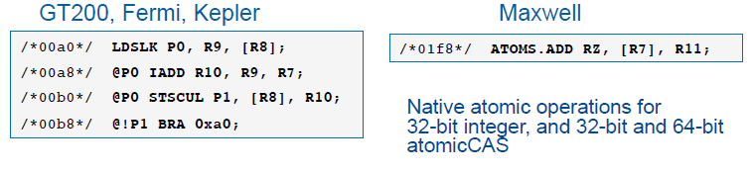
Synchronization
Arithmetic functions
Add, sub, max, min, exch, inc, dec, CAS
Bitwise functions
And, or, xor
CUDA: int atomicAdd(int*, int);
PTX: atom.shared.add.u32 &r25, [%rd14],1;
SASS:
Lock/update/unlock vs native atomic

Slide 53
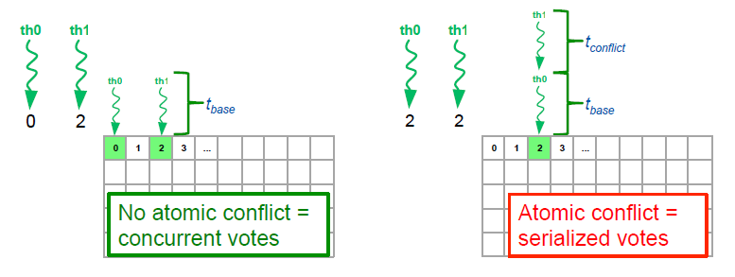
Synchronization
Atomic conflict degree
Intra-warp conflict degree from 1 to 32

